Slide 1
Crop yield prediction using Ai
Manjunath D Eng19CS0170

Slide 2
INTRODUCTION
Crop yield prediction is extremely challenging due to its dependence on multiple factors such as crop genotype, environmental factors, management practices, and their interactions.

Slide 3
Why ??
Crop yield prediction is an essential task for the decision-makers at national and regional levels (e.g., the EU level) for rapid decision-making
Predictions could be used by crop managers to minimize losses when
unfavorable conditions may occur.
An accurate crop yield prediction model can help farmers to decide on what to grow and when to grow. There are different approaches to crop yield prediction.

Slide 4
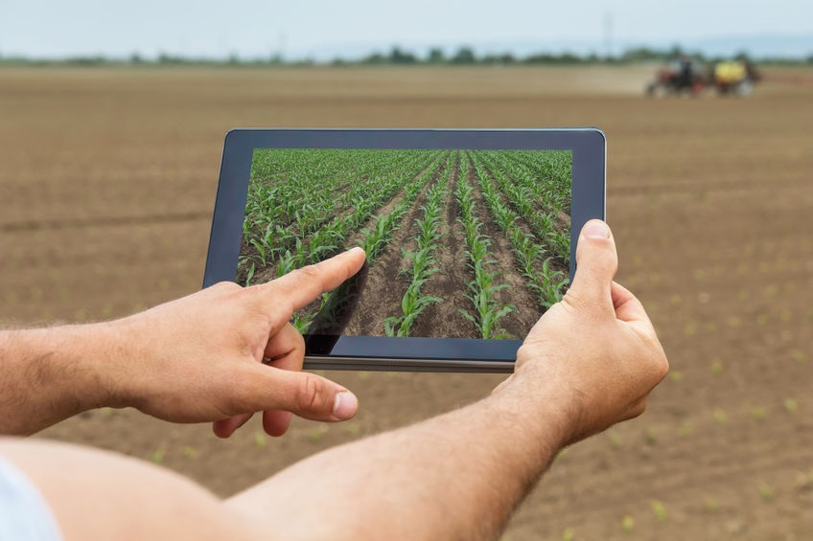
overview
AI can provide farmers with real-time insights from their fields, allowing them to identify areas that need irrigation, fertilization, or pesticide treatment. Also, This methodology helps in increasing food production while minimizing the use of resource.

Slide 5

Technology Used
If we are using Numerical data then, we can use Artificial Neural Network ,Random Forest and LSTM for the better prediction.
Artificial Neural Networks (ANN) have been demonstrated to be powerful tools for modeling and prediction.
If we go with the Image data we can use Convolution Neural network (CNN).

Slide 6
DESIGN FLOW
The process of developing the proposed system involves the following process:
Data collection/ Preparation
Build the Prediction Model
Crop prediction

Slide 7
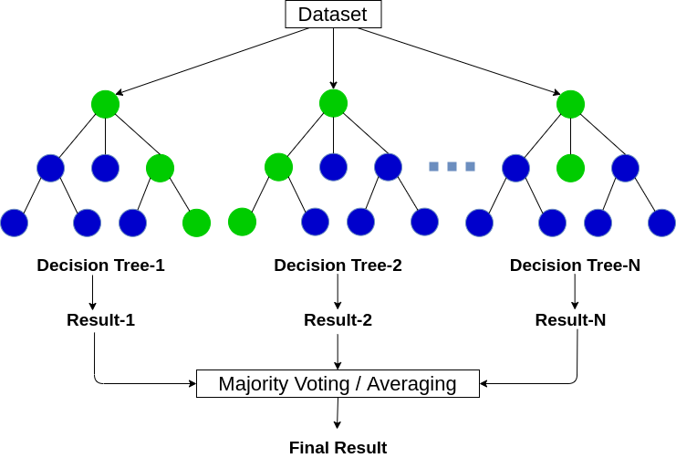
Random Forest

Slide 8
Conclusion
Predicting crop yield is essential for the food production ecosystem around the world. With better data in hand, it becomes possible to make informed decisions. Government agencies also find the crop yield prediction data useful as they can plan accordingly for national food security.

Slide 9
Thank You

